Slide 1
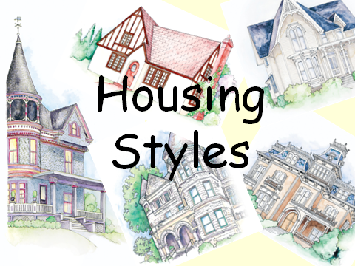
http://www.cteonline.org/portal/default/Curriculum/Viewer/Curriculum?action=2&cmobjid=393430&view=viewer&refcmobjid=393426

Slide 2
EARLY HOMES

Slide 3
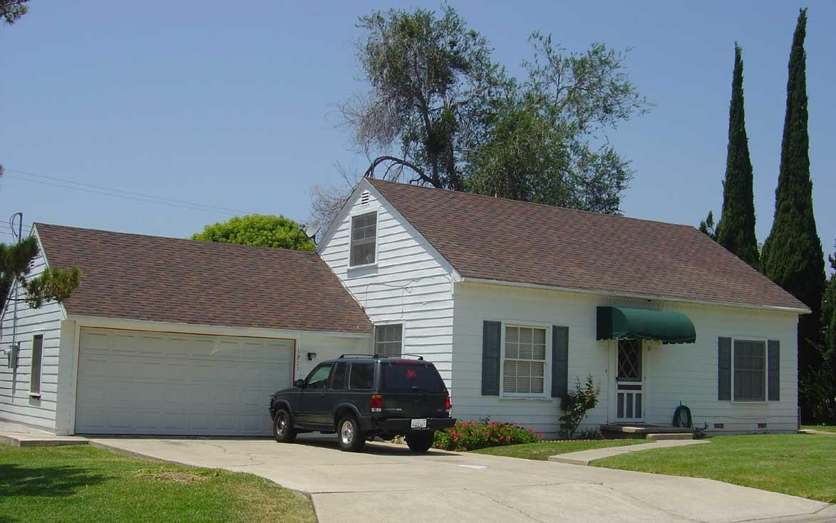
Cape Cod
English
1600’s
Central Chimney
1 – 1 ½ stories
Symmetrical
Clapboard siding or
shingles
Dormers optional
Gable roof

Slide 4
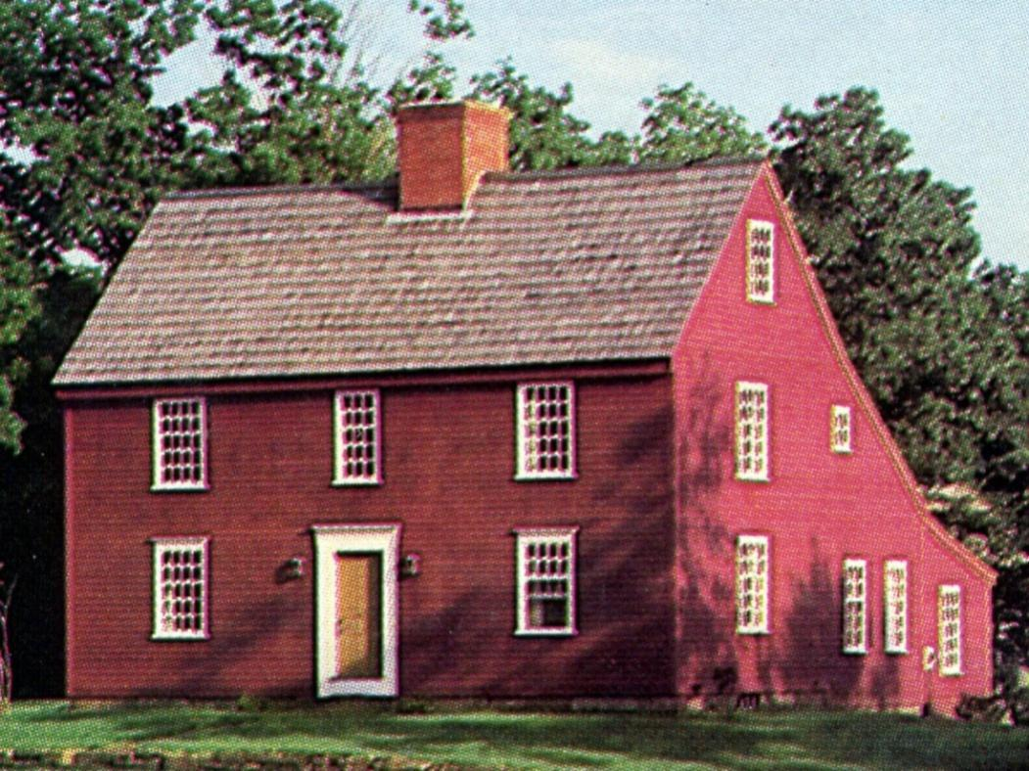
Saltbox
1700 – 1760
Began as a 2-story
with gable roof, 1st
floor extended out
Saltbox roof
Central chimney
Clapboard siding

Slide 5
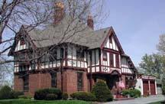
English Tudor
1600 – 1700
English
Half-timber – wood
frame exposed
Wood, plaster, or
brick exterior
Steep gable roof
Thatch or shingle
Narrow windows

Slide 6
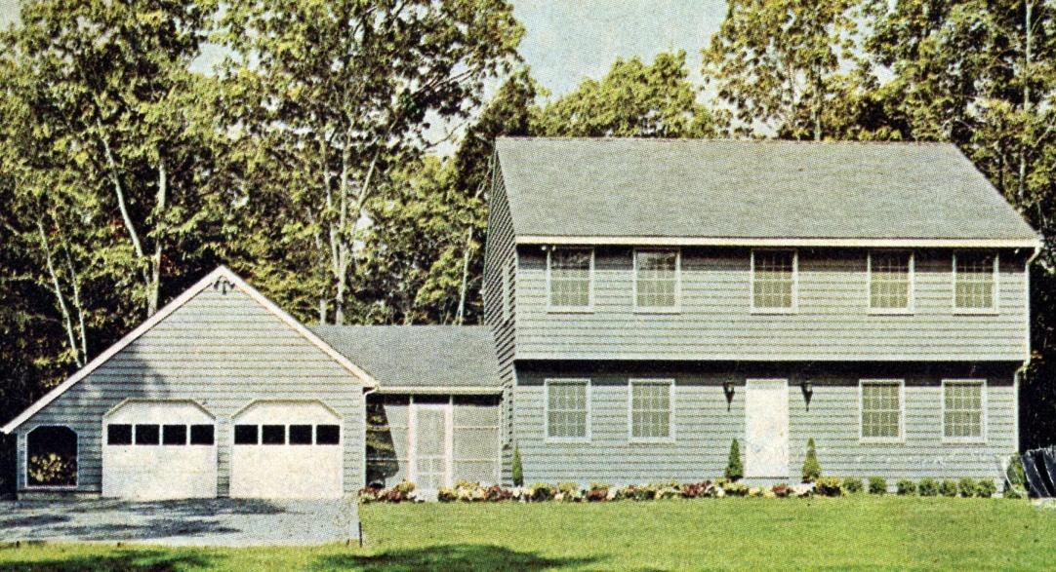
Garrison
1600’s
Steep gable roof
Central fireplace
Clapboard or brick
2nd floor overhangs
first floor-protection

Slide 7
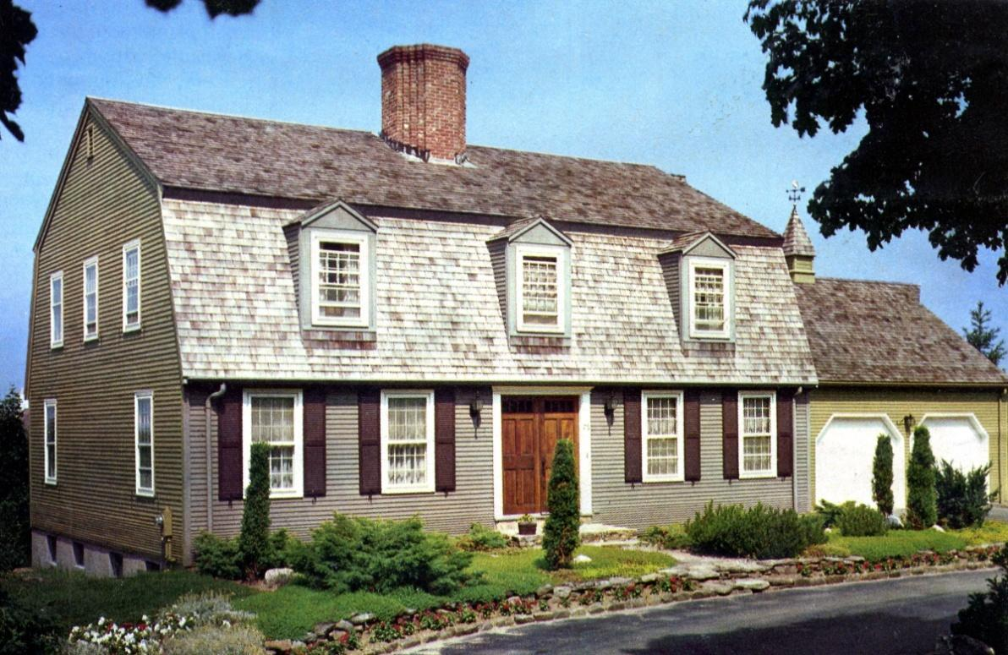
Dutch Colonial
Late 1600’s
New York and
Delaware
Gambrel Roof
Up to 5 stories
Stone and brick
Dutch “kick” (flaring
eaves)
Dormer windows
“Dutch” doors

Slide 8
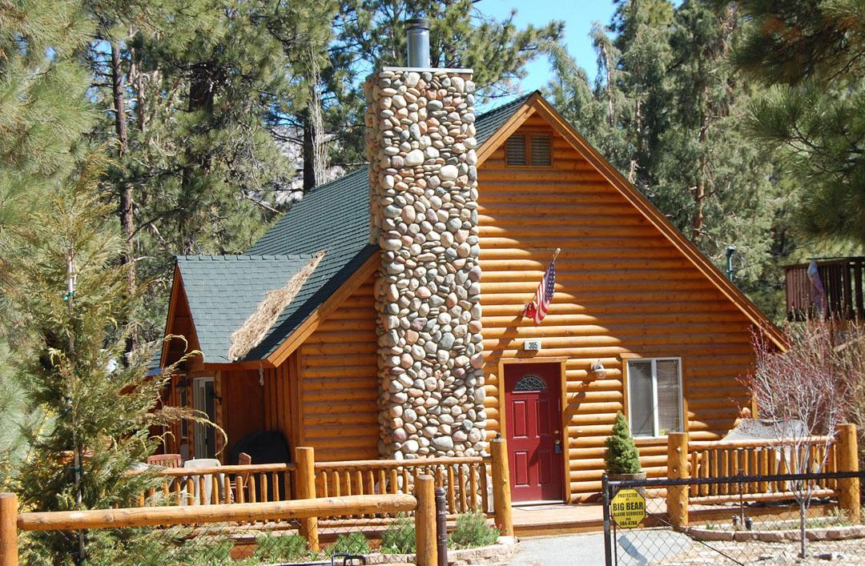
Log cabin
1500’s
One story
Chimney on one end
Steep gable roof
Exterior of logs
Size of house
dependant on length
of logs

Slide 9
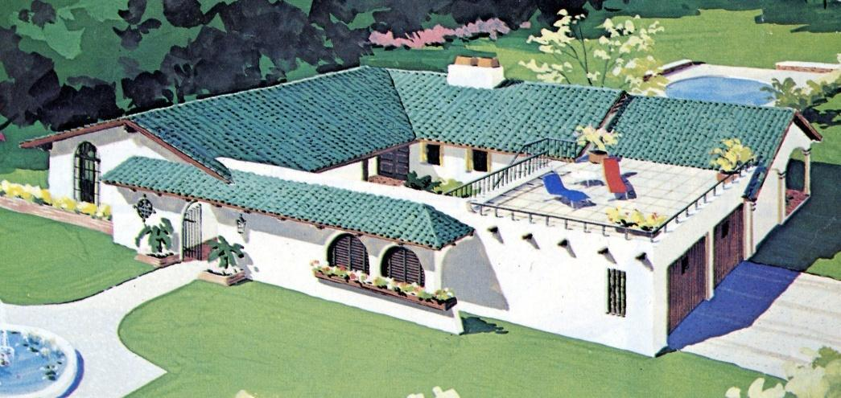
Spanish
1600 - 1800’s
White or tinted stucco
Low-pitch tile roofs
Rolled or barrel-style
tile roof
Wide porches
Arched windows,
doors and colonnades
Wrought iron railings
and grills

Slide 10
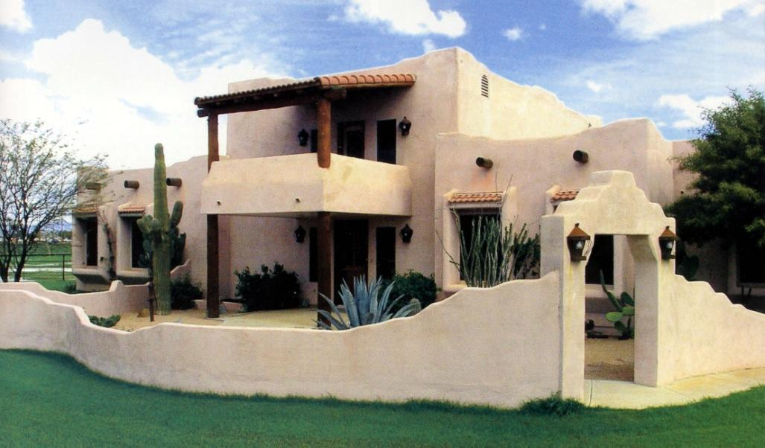
Pueblo
Made of adobe clay
Often called “Adobe”
1400’s
Southwest
Pole beams
Deep-set windows
Thick walls
Flat roofs

Slide 11
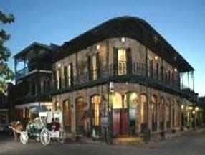
Louisiana French
1700’s
New Orleans
Two chimneys
Hip roof
Raised to protect
from flooding
Brick, stone or stucco
Lacy ironwork and
railings

Slide 12
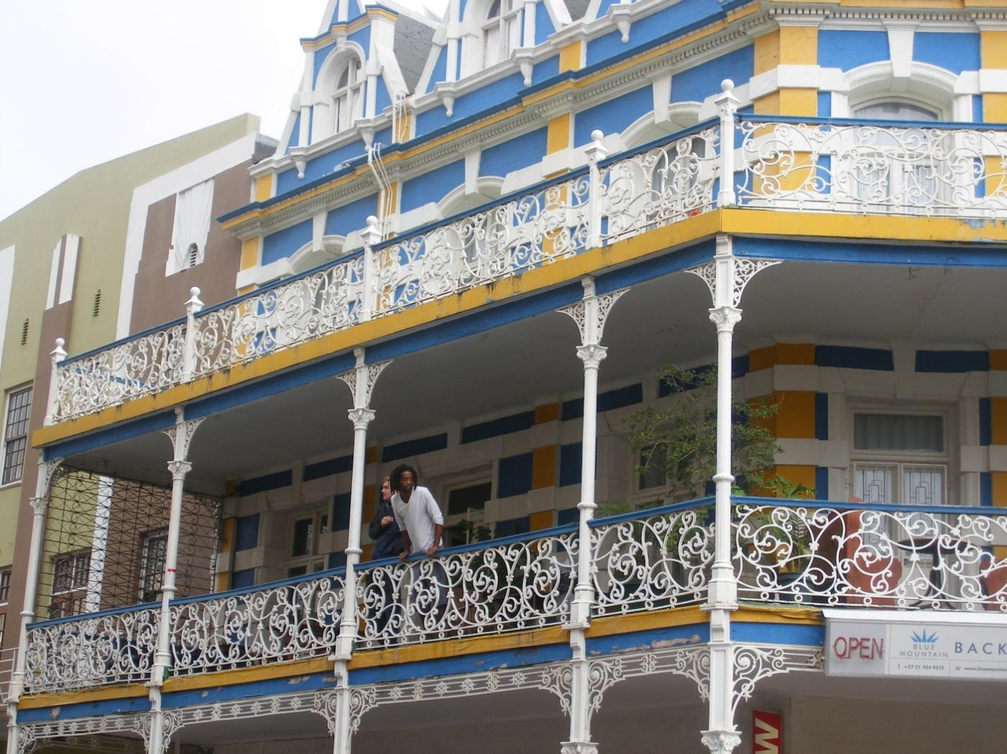

Slide 13
18TH CENTURY

Slide 14
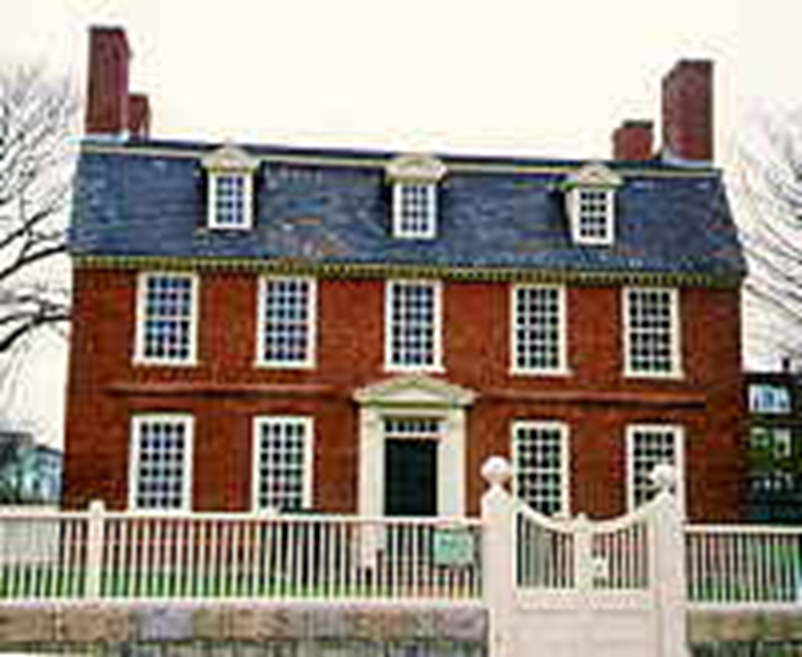
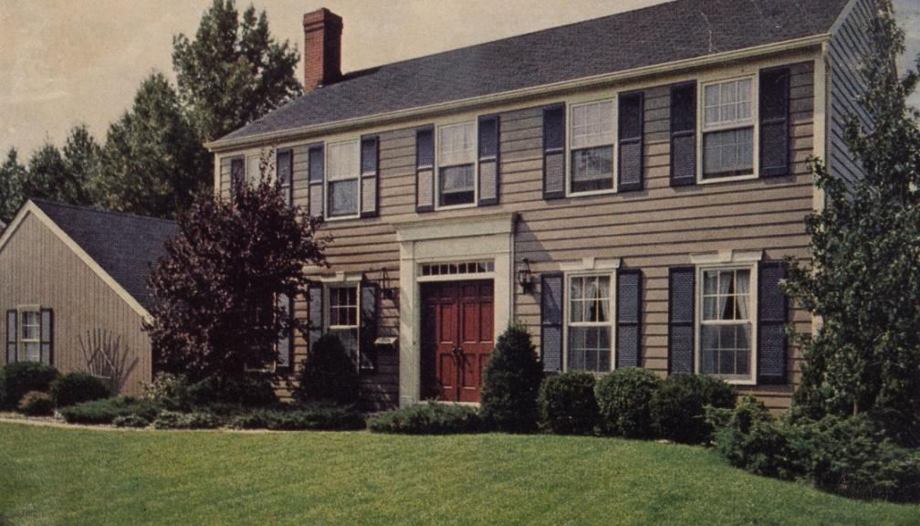
Georgian
Symmetrical, formal
1700 – 1780
Clapboard, brick or stone
2 ½ - 3 stories
High hip or gable roof,
possible dormers, or flat
top with balustrade
Paneled centered door
Pilasters, quoins, cornices
Central or end chimneys
Pediment above door may
be broken, triangle,
scrolled or segmental

Slide 15
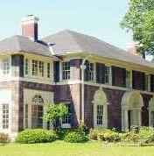
Later Georgian
Palladian Windows

Slide 16
19th Century

Slide 17
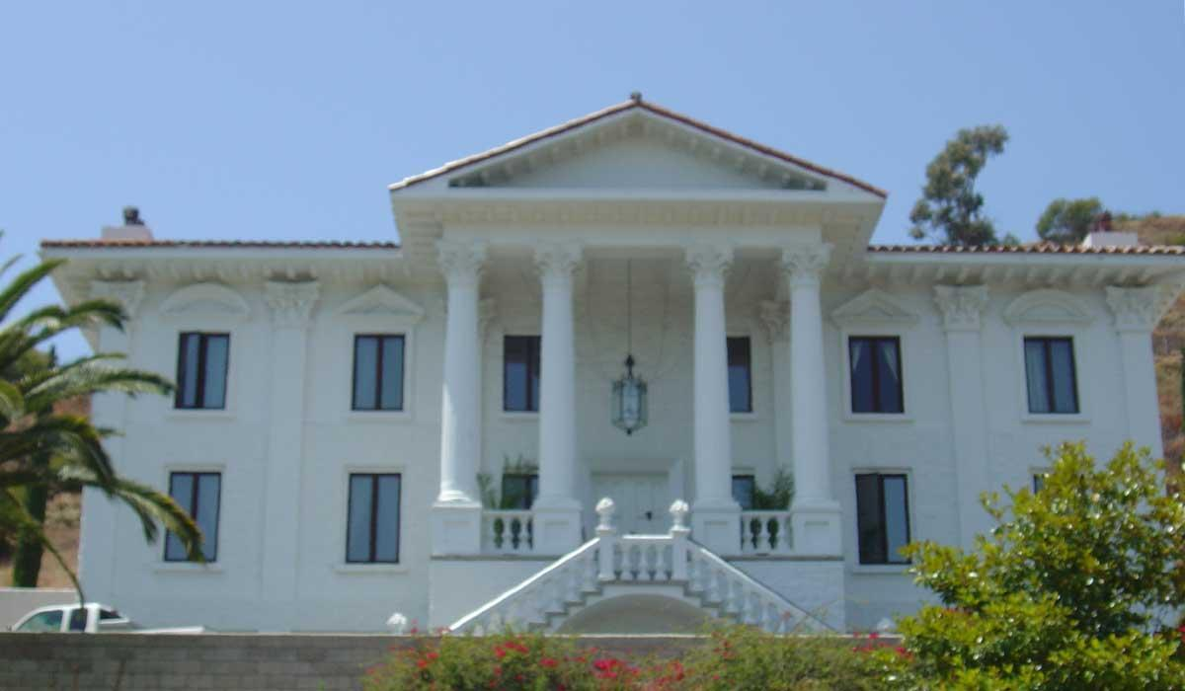
Greek Revival
Large and rectangular
Two-story portico
Greek columns or
pilasters
Dentil cornice
Government buildings
Elaborate entrance

Slide 18
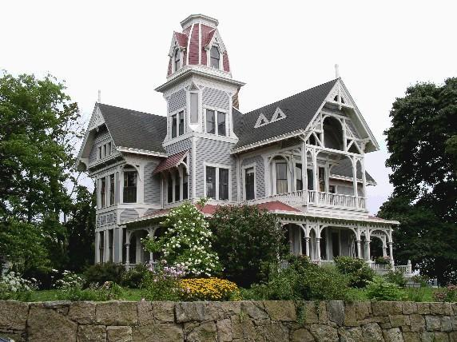
Victorian – Queen Anne
1870 – 1890’s
Decorative trimmings -
“gingerbread” – elaborate
highly decorative
woodwork
Colorful
Tall windows
Large porches

Slide 19
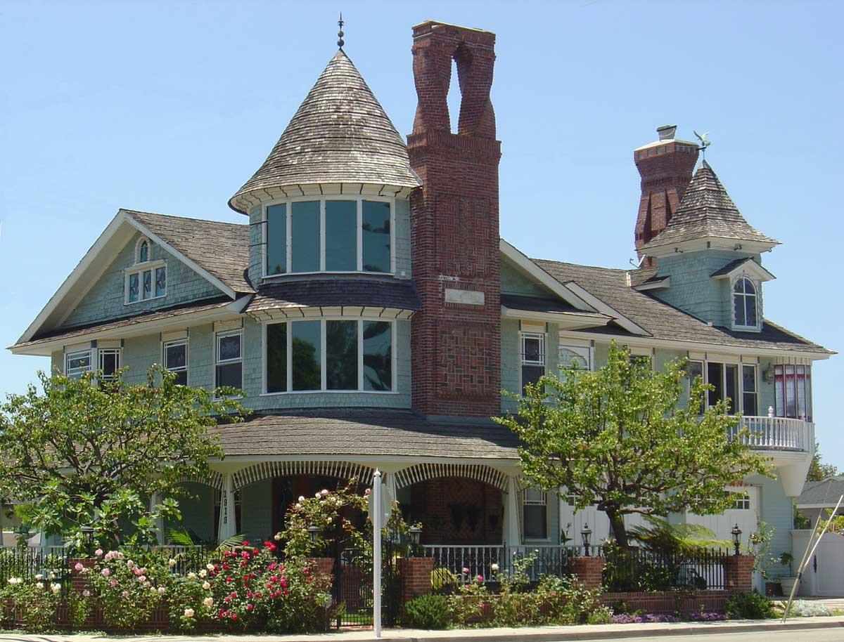
Victorian – Queen Anne
Stained glass windows
Large chimneys
Many balconies
Steep gabled roofs
Irregular roof shapes
Decorative shingles

Slide 20
20th century

Slide 21
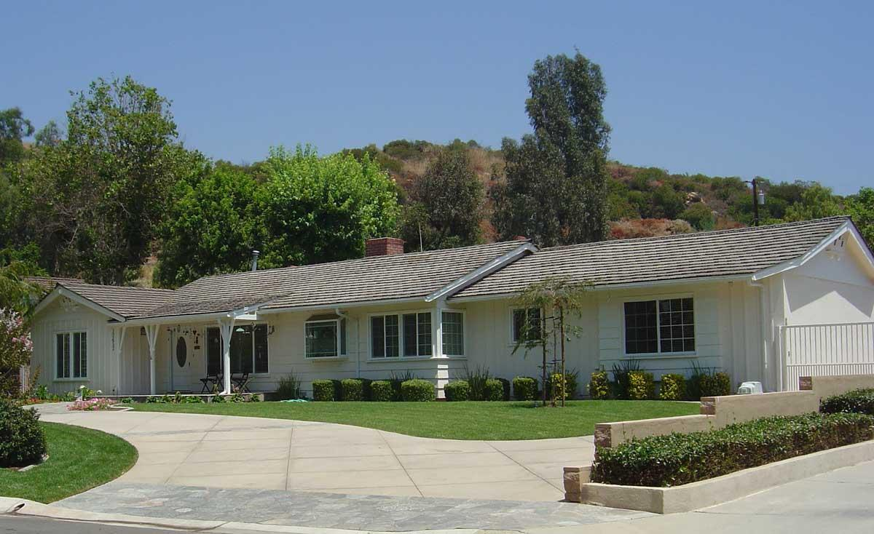
Ranch
1920’s - present
Long, low one-story
Low, pitched gable roof
Large areas of windows
Patio sliders
Brick, stucco, clapboard
Usually rectangular
shaped, but may be L,
T, U, or H shaped

Slide 22
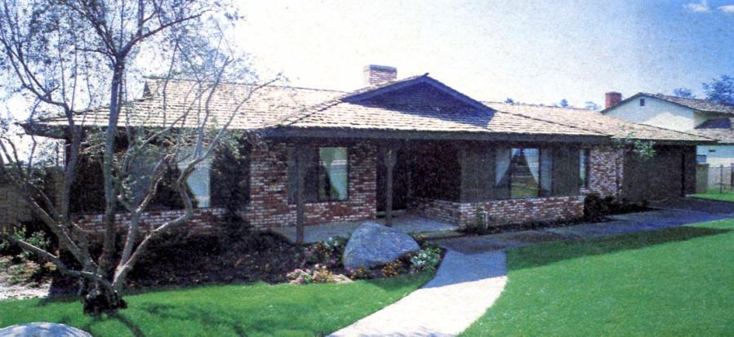
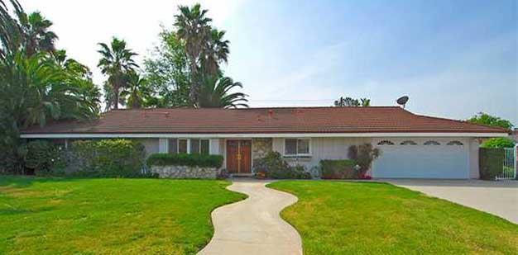
Ranch

Slide 23
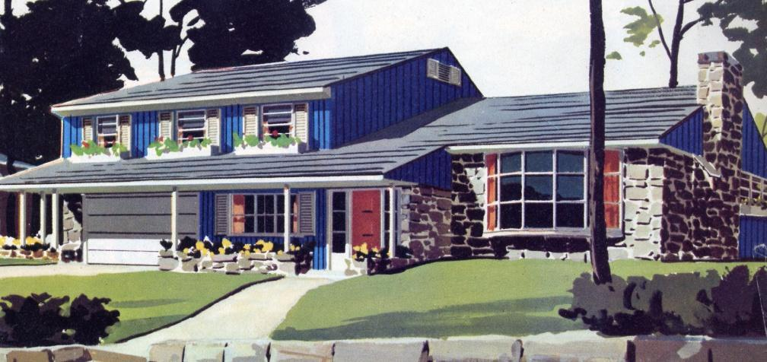
Split-Level
1950’s – present
Able to take advantage
of “hilly” lots
Usually 3 “levels”
connected with short
flight of stairs
Large windows
Overhanging eaves
Brick, stucco, clapboard
Low pitched gable or hip
roof

Slide 24
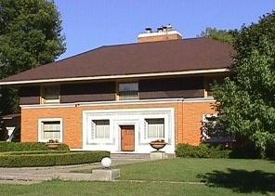
Prairie
Frank Lloyd Wright
1900 – 1920’s
Flat or low gable or
hip roofs
Strong horizontal lines
Low and spread out
Long panels of windows
Leaded glass windows
Rooms flow into each other
Brick or stucco

Slide 25
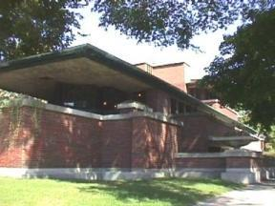
Prairie

Slide 26
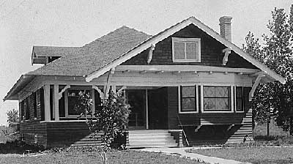
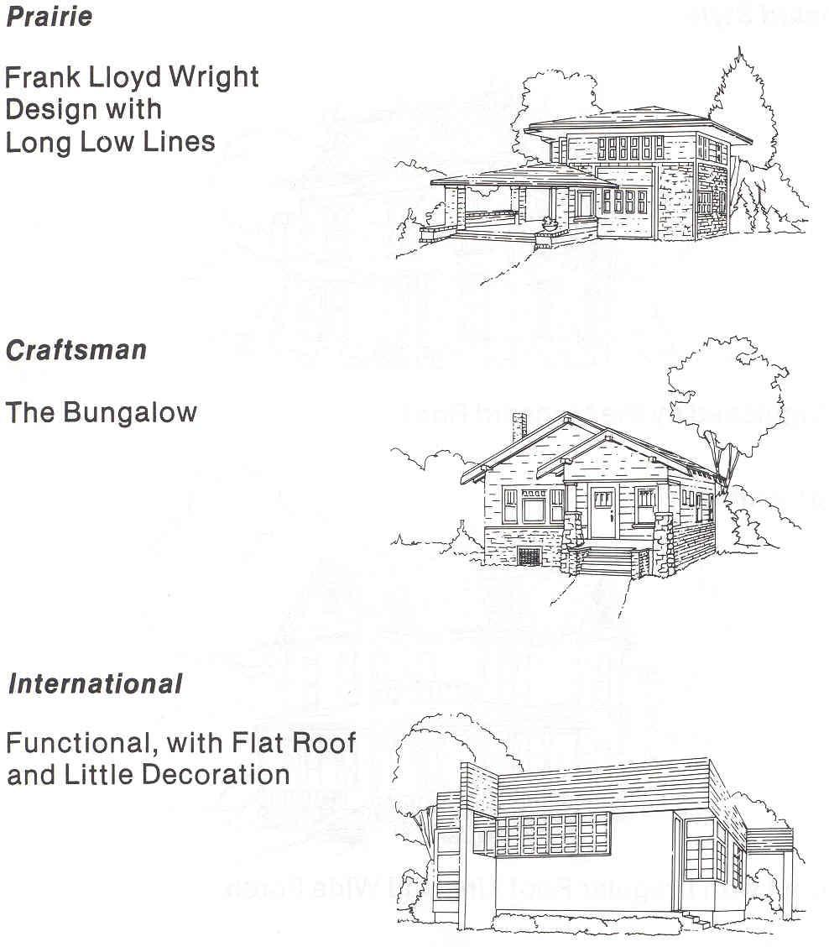
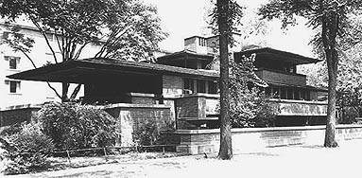
Housing Styles
Twentieth Century

Slide 27
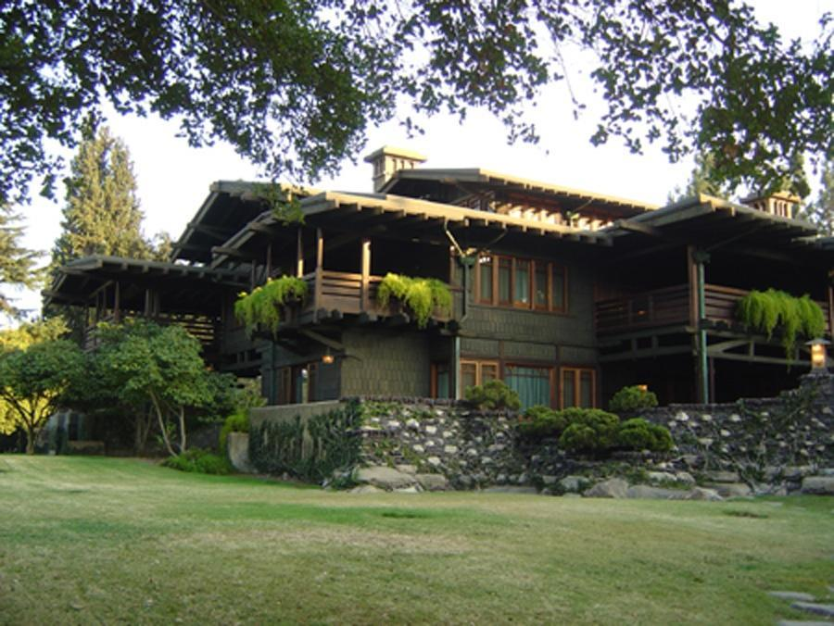
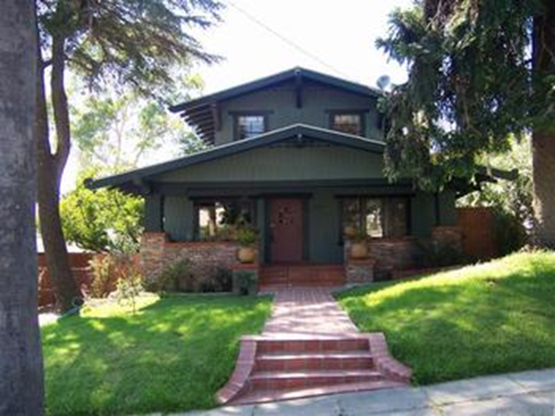
Craftsman / Bungalow
1905 - 1939
Greene brothers strong
influence
Gamble house
Low pitch gable or hip
Large overhangs
Wide porches
Decorative beams or braces
Natural materials
Hand crafted
Clapboard or shingle

Slide 28
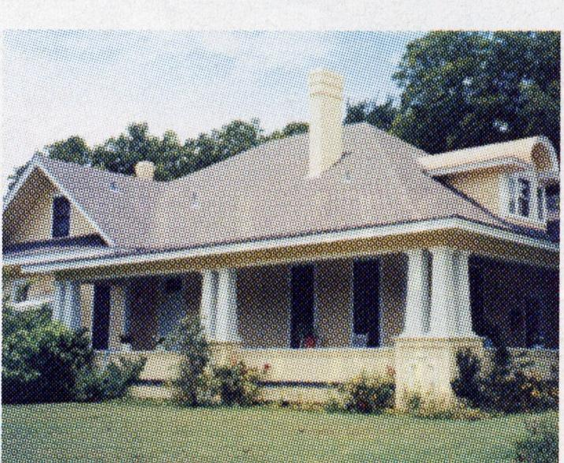
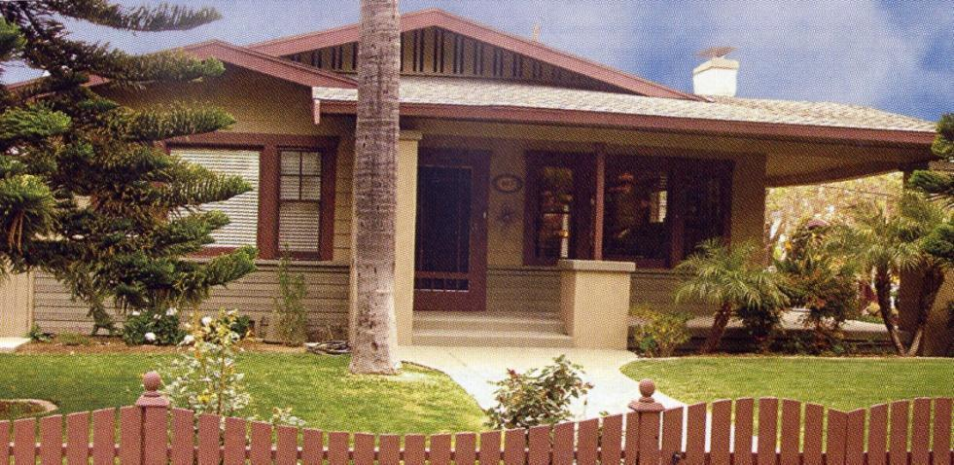
Craftsman / Bungalow

Slide 29
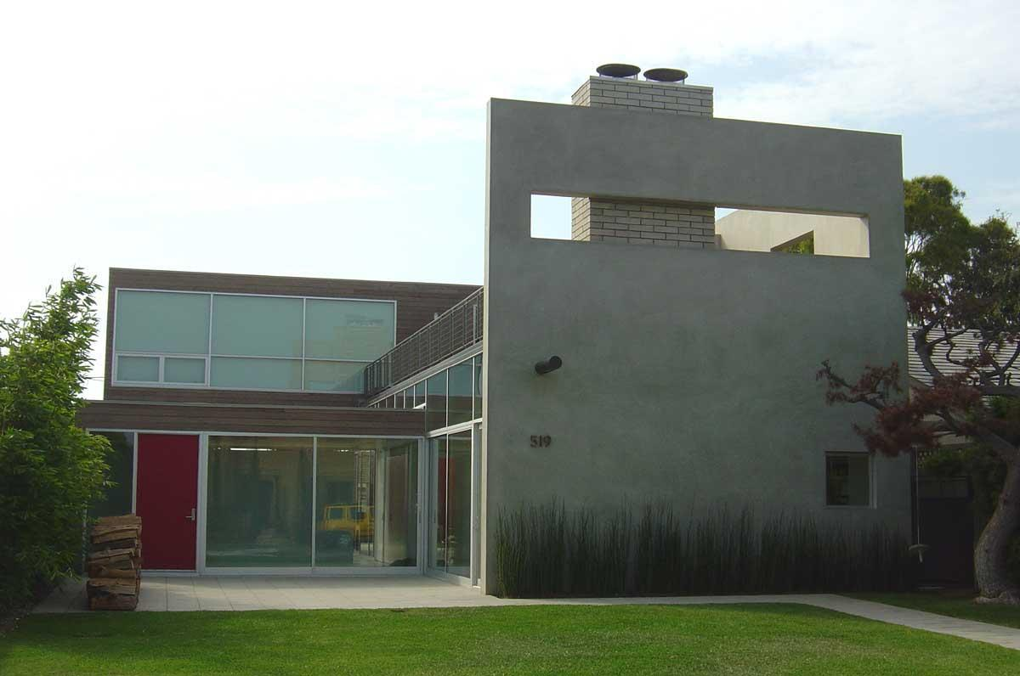
International
1925 – present
Emphasize function of area
Geometric design
Flat roof
Non-traditional forms of
houses
Large expanses of windows
or concrete

Slide 30
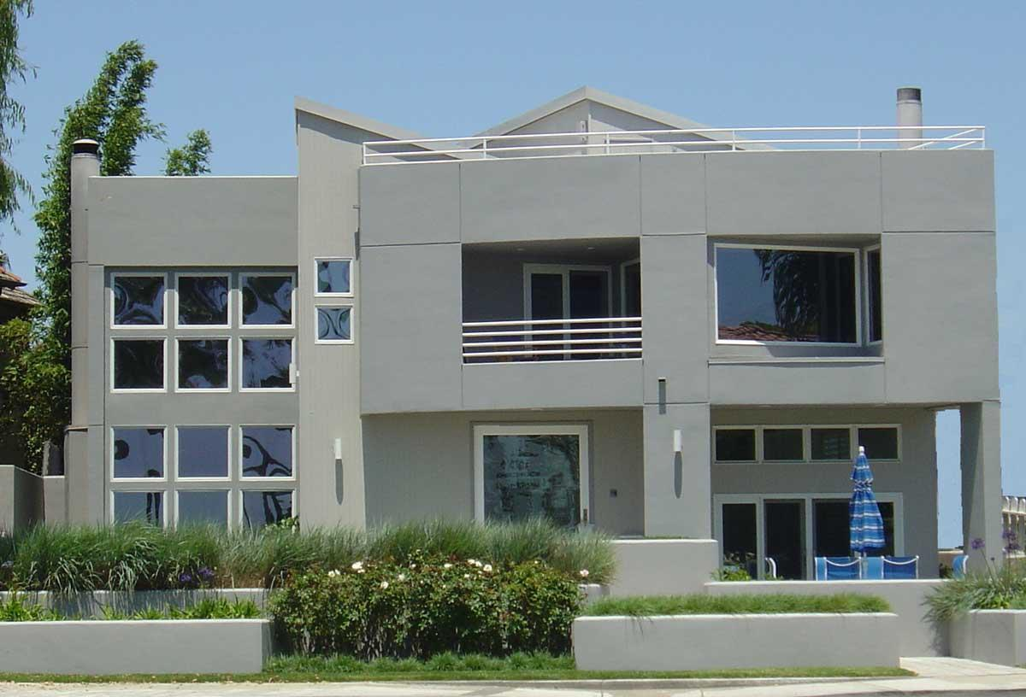
International

Slide 31
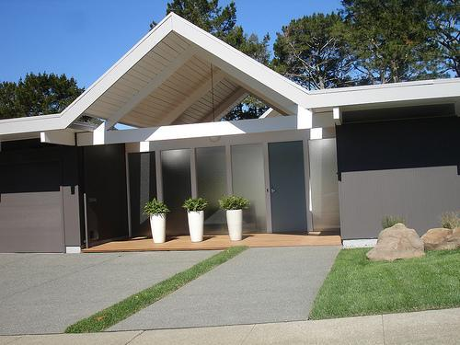
Mid Century modern

Slide 32
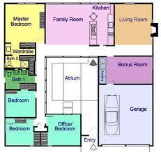

Slide 33
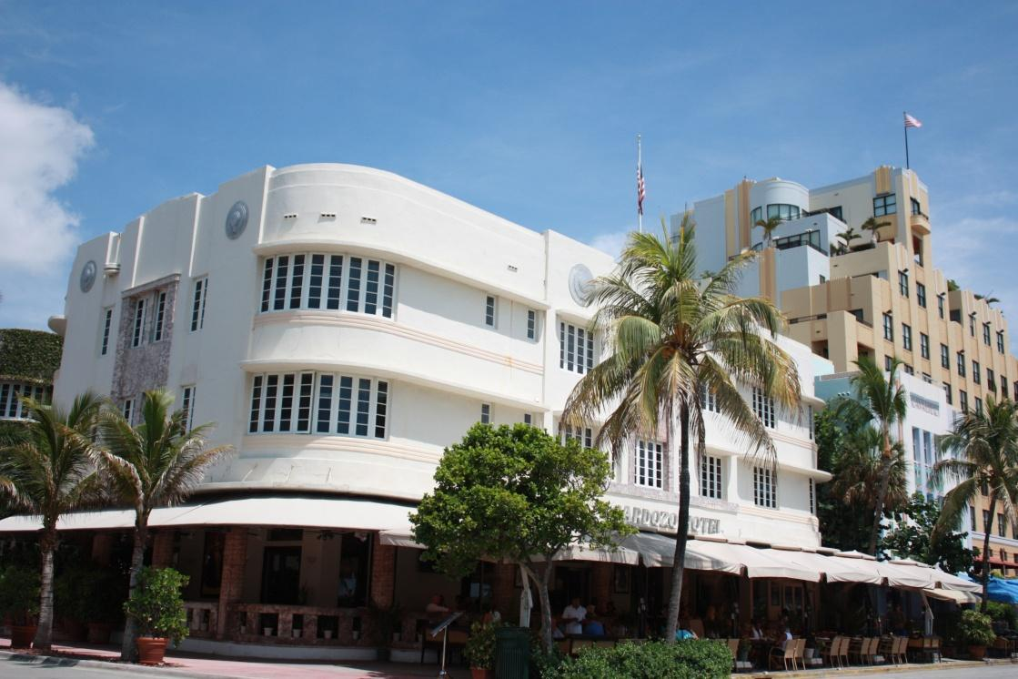
Art deco
Rounded corners
Flat roofs
1930’s & 40’s
Reminds us of trains, airplanes ships

Slide 34
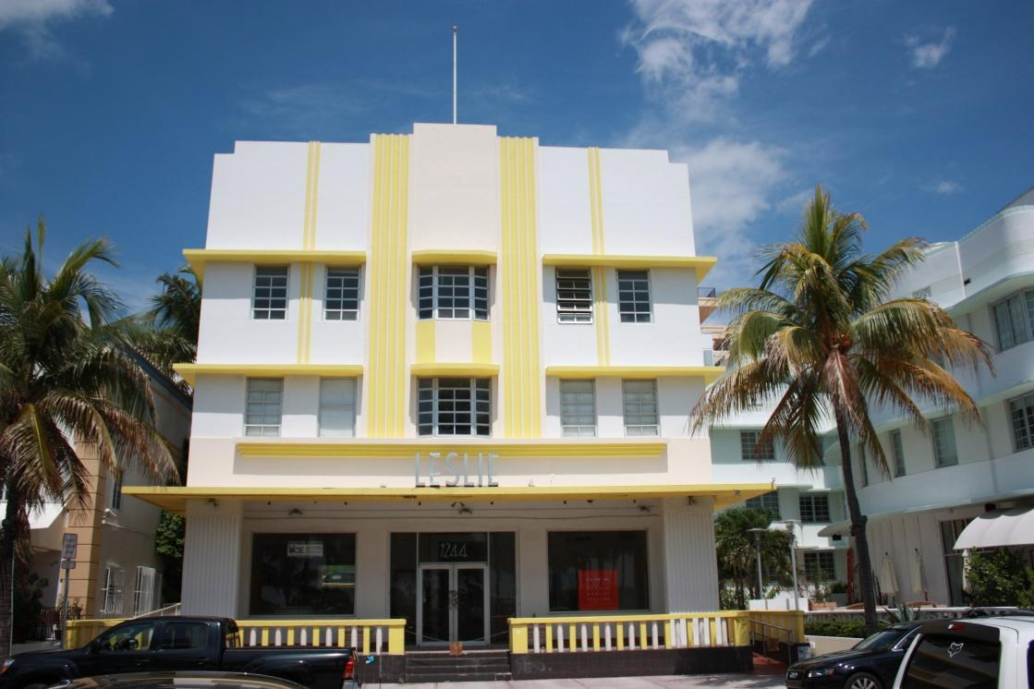
Eyebrows,
Threes – stories, windows, portholes
Steps - up

Slide 35
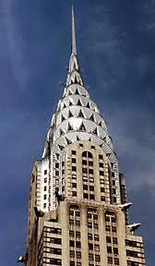

Slide 36
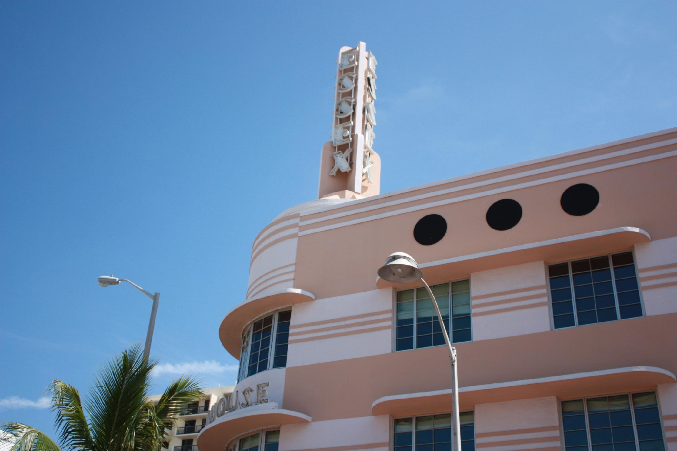

Slide 37
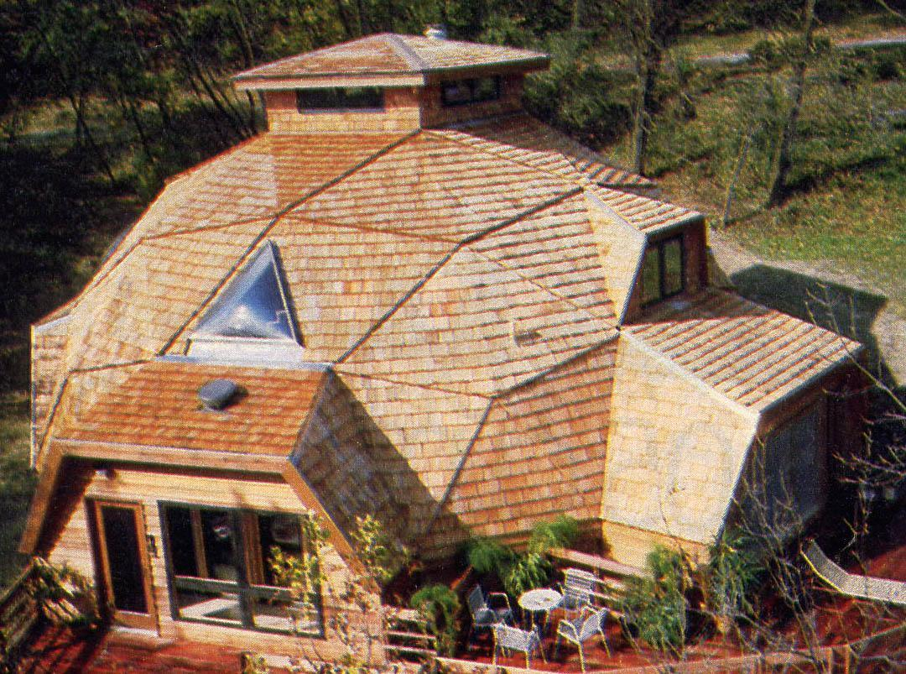
Geodesic Dome
R. Buckminster Fuller
Mid-1940 - present
Triangular frames – metal or
plastic
Efficient structure
Minimizes building materials
Flexible “skin” or rigid panels
Energy efficient
No interior or exterior
support systems (walls)
except for privacy

Slide 38
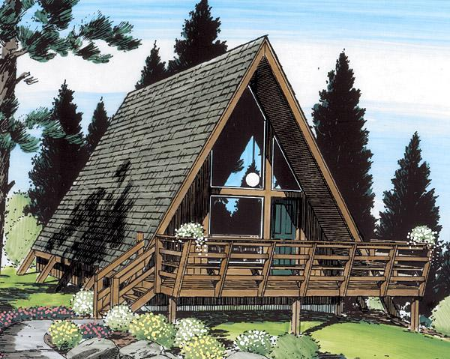
A-frame
Steep roof that extends to the ground
Usually found in mountains - to ease snow load
Large windows in the front and back of structure

Slide 39
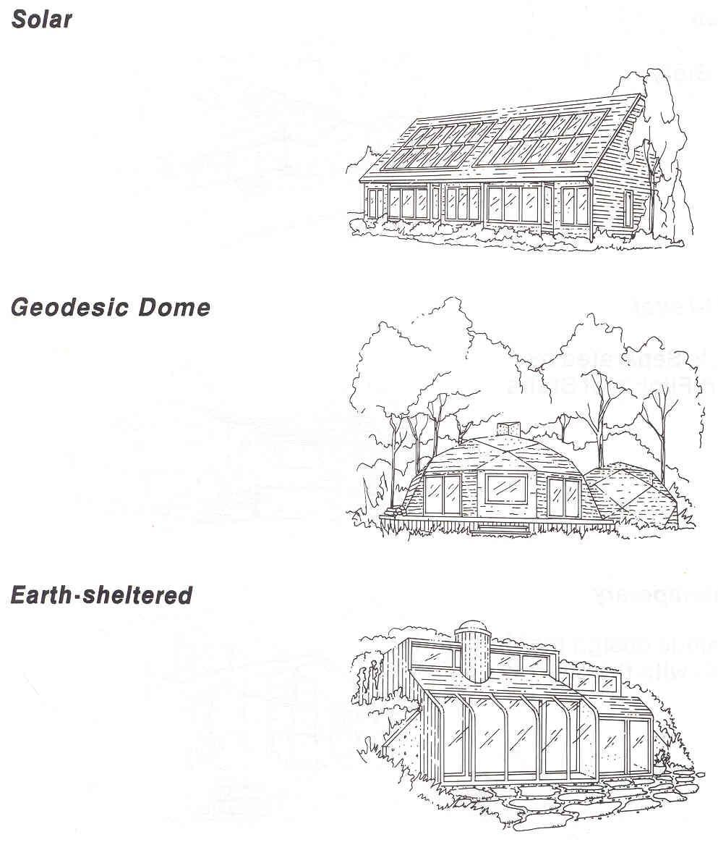
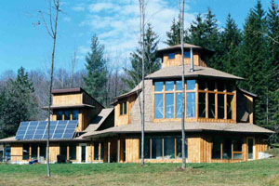
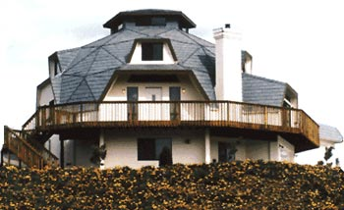
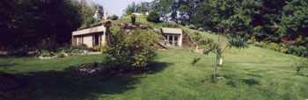
Housing Styles
Current

Slide 40
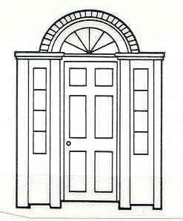
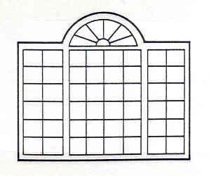
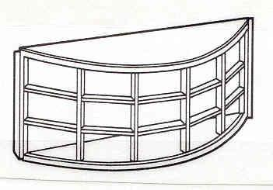
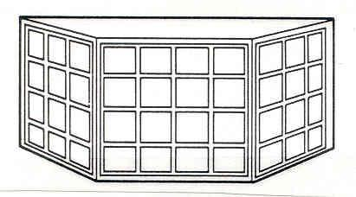
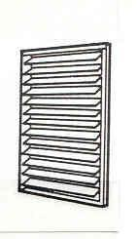
Types of Windows

Slide 41
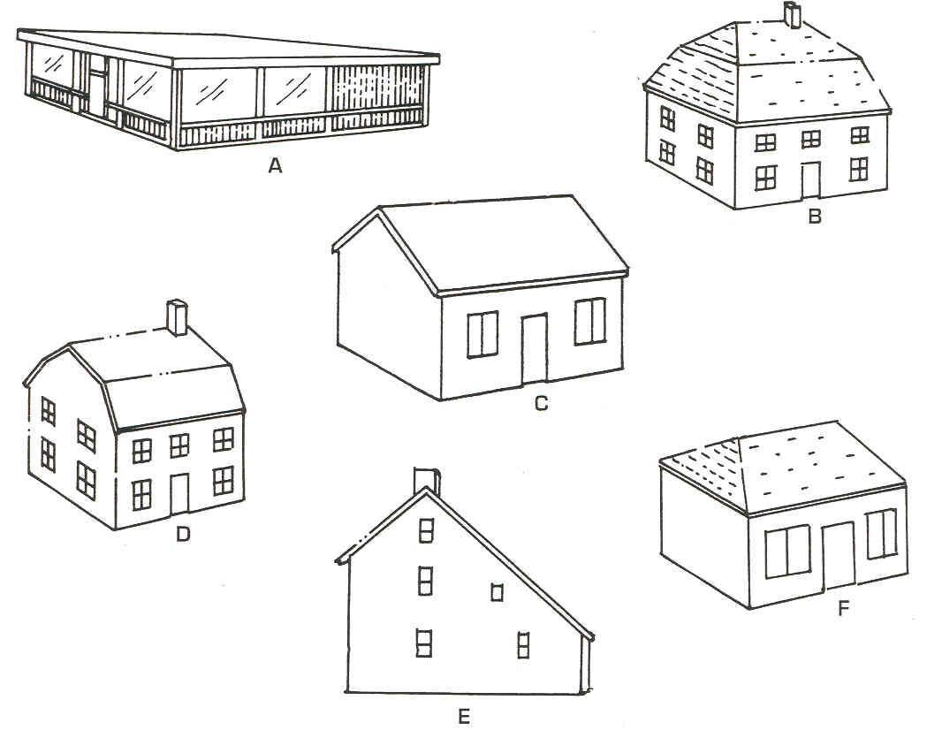
Roof Styles

